Slide 1
Introduction to Matlab

Slide 2
Outline:
What is Matlab?
Matlab Screen
Variables, array, matrix, indexing
Operators (Arithmetic, relational, logical )
Display Facilities
Flow Control
Using of M-File
Writing User Defined Functions
Conclusion

Slide 3
What is Matlab?
Matlab is basically a high level language which has many specialized toolboxes for making things easier for us
How high?
Matlab
High Level
Languages such as
C, Pascal etc.
Assembly

Slide 4
What are we interested in?
Matlab is too broad for our purposes in this course.
The features we are going to require is
Matlab
Series of Matlab commands
m-files
Command
Line
mat-files
functions
Command execution like DOS command window
Data storage/ loading
Input
Output
capability

Slide 5
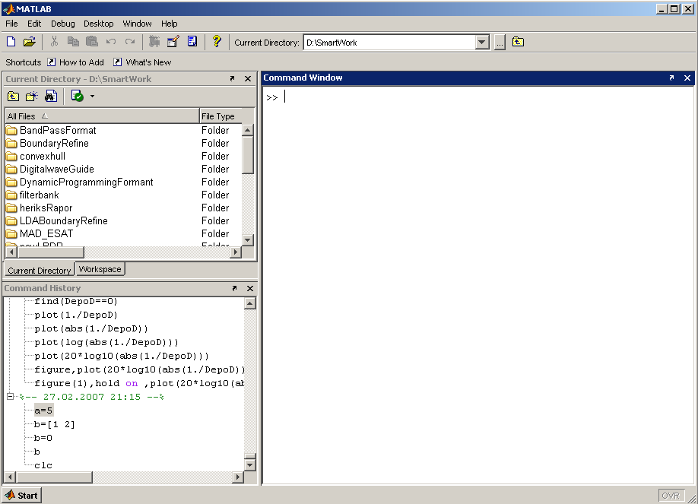
Matlab Screen
Command Window
  type commands
Current Directory
  View folders and m-files
Workspace
  View program variables
  Double click on a variable
  to see it in the Array Editor
Command History
  view past commands
  save a whole session
  using diary

Slide 6
Variables
No need for types. i.e.,
All variables are created with double precision unless specified and they are matrices.
After these statements, the variables are 1x1 matrices with double precision
int a;
double b;
float c;
Example:
>>x=5;
>>x1=2;

Slide 7
Array, Matrix
a vector x = [1 2 5 1]
x =
1 2 5 1
a matrix x = [1 2 3; 5 1 4; 3 2 -1]
x =
1 2 3
5 1 4
3 2 -1
transpose y = x’ y =
1
2
5
1

Slide 8
Long Array, Matrix
t =1:10
t =
1 2 3 4 5 6 7 8 9 10
k =2:-0.5:-1
k =
2 1.5 1 0.5 0 -0.5 -1
B = [1:4; 5:8]
x =
1 2 3 4
5 6 7 8

Slide 9
Generating Vectors from functions
zeros(M,N) MxN matrix of zeros
ones(M,N) MxN matrix of ones
rand(M,N) MxN matrix of uniformly distributed random
numbers on (0,1)
x = zeros(1,3)
x =
0 0 0
x = ones(1,3)
x =
1 1 1
x = rand(1,3)
x =
0.9501 0.2311 0.6068

Slide 10
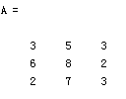


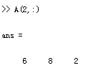

Matrix Index
The matrix indices begin from 1 (not 0 (as in C))
The matrix indices must be positive integer
Given:
A(-2), A(0)
Error: ??? Subscript indices must either be real positive integers or logicals.
A(4,2)
Error: ??? Index exceeds matrix dimensions.

Slide 11
Concatenation of Matrices
x = [1 2], y = [4 5], z=[ 0 0]
A = [ x y]
1 2 4 5
B = [x ; y]
1 2
4 5
C = [x y ;z]
Error:
??? Error using ==> vertcat CAT arguments dimensions are not consistent.

Slide 12
Operators (arithmetic)
+ addition
- subtraction
* multiplication
/ division
^ power
‘ complex conjugate transpose

Slide 13
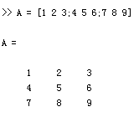
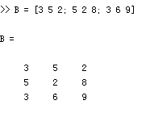
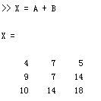
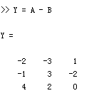
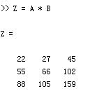
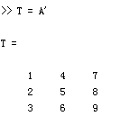
Matrices Operations
Given A and B:
Addition
Subtraction
Product
Transpose

Slide 14
Operators (Element by Element)
.* element-by-element multiplication
./ element-by-element division
.^ element-by-element power

Slide 15
The use of “.” – “Element” Operation
A = [1 2 3; 5 1 4; 3 2 1]
A =
1 2 3
5 1 4
3 2 -1
b = x .* y
b=
3 8 -3
c = x . / y
c=
0.33 0.5 -3
d = x .^2
d=
1 4 9
x = A(1,:)
x=
1 2 3
y = A(3 ,:)
y=
3 4 -1
K= x^2
Erorr:
??? Error using ==> mpower Matrix must be square.
B=x*y
Erorr:
??? Error using ==> mtimes Inner matrix dimensions must agree.

Slide 16
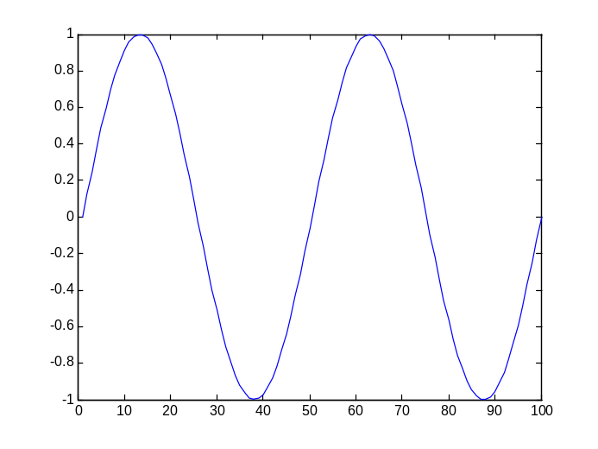
Basic Task: Plot the function sin(x) between 0≤x≤4π
Create an x-array of 100 samples between 0 and 4π.
Calculate sin(.) of the x-array
Plot the y-array
>>x=linspace(0,4*pi,100);
>>y=sin(x);
>>plot(y)

Slide 17
Plot the function e^{-x/3}sin(x) between 0≤x≤4π
Create an x-array of 100 samples between 0 and 4π.
Calculate sin(.) of the x-array
Calculate e^{-x/3} of the x-array
Multiply the arrays y and y1
>>x=linspace(0,4*pi,100);
>>y=sin(x);
>>y1=exp(-x/3);
>>y2=y*y1;

Slide 18
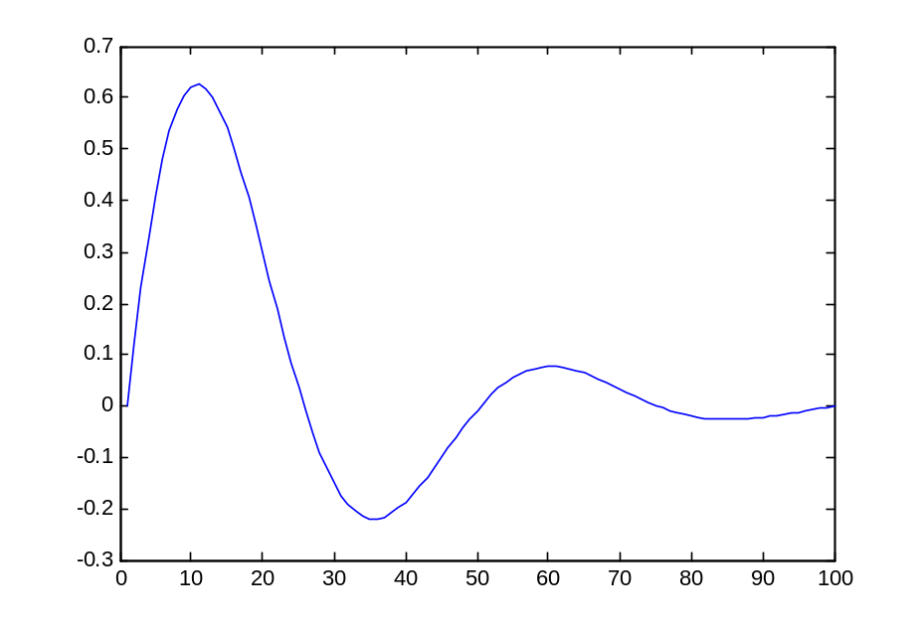
Plot the function e^{-x/3}sin(x) between 0≤x≤4π
Multiply the arrays y and y1 correctly
Plot the y2-array
>>y2=y.*y1;
>>plot(y2)

Slide 19
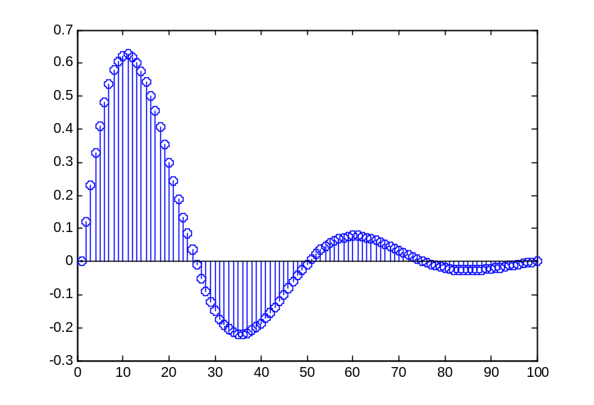
Display Facilities
plot(.)
stem(.)
Example:
>>x=linspace(0,4*pi,100);
>>y=sin(x);
>>plot(y)
>>plot(x,y)
Example:
>>stem(y)
>>stem(x,y)

Slide 20
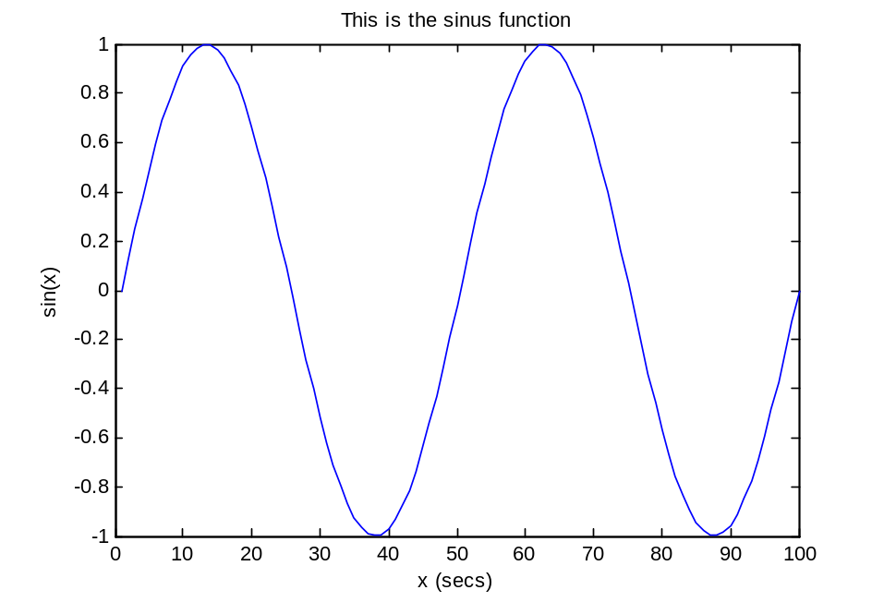
Display Facilities
title(.)
xlabel(.)
ylabel(.)
>>title(‘This is the sinus function’)
>>xlabel(‘x (secs)’)
>>ylabel(‘sin(x)’)

Slide 21
Operators (relational, logical)
== Equal to
~= Not equal to
< Strictly smaller
> Strictly greater
<= Smaller than or equal to
>= Greater than equal to
& And operator
| Or operator

Slide 22
Flow Control
if
for
while
break
….

Slide 23
Control Structures
Some Dummy Examples
if ((a>3) & (b==5))
Some Matlab Commands;
end
if (a<3)
Some Matlab Commands;
elseif (b~=5)
Some Matlab Commands;
end
if (a<3)
Some Matlab Commands;
else
Some Matlab Commands;
end
If Statement Syntax
if (Condition_1)
Matlab Commands
elseif (Condition_2)
Matlab Commands
elseif (Condition_3)
Matlab Commands
else
Matlab Commands
end

Slide 24
Control Structures
Some Dummy Examples
for i=1:100
Some Matlab Commands;
end
for j=1:3:200
Some Matlab Commands;
end
for m=13:-0.2:-21
Some Matlab Commands;
end
for k=[0.1 0.3 -13 12 7 -9.3]
Some Matlab Commands;
end
For loop syntax
for i=Index_Array
Matlab Commands
end

Slide 25
Control Structures
While Loop Syntax
while (condition)
Matlab Commands
end
Dummy Example
while ((a>3) & (b==5))
Some Matlab Commands;
end

Slide 26
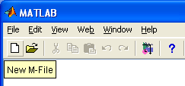
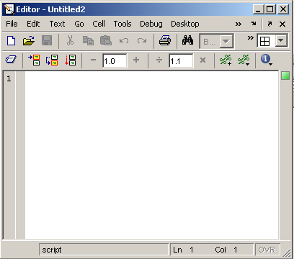
Use of M-File
Click to create a new M-File
Extension “.m”
A text file containing script or function or program to run

Slide 27
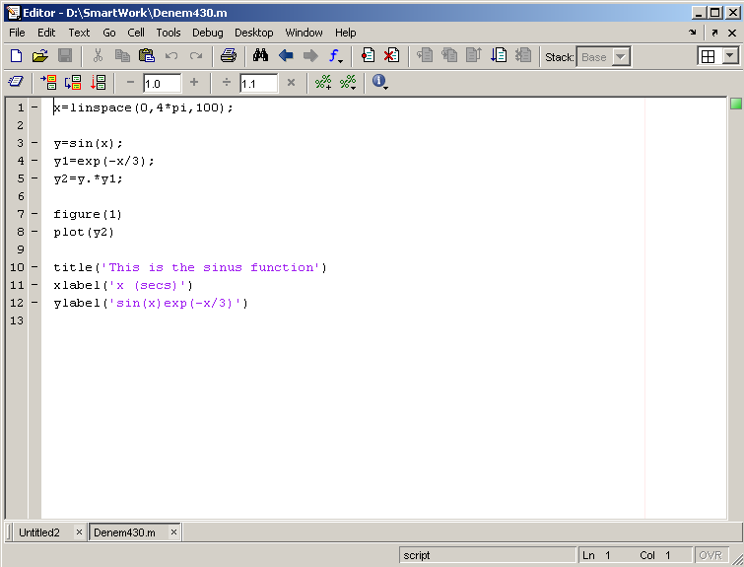
Use of M-File
Save file as Denem430.m
If you include “;” at the
end of each statement,
result will not be shown
immediately

Slide 28
Writing User Defined Functions
Functions are m-files which can be executed by specifying some inputs and supply some desired outputs.
The code telling the Matlab that an m-file is actually a function is
You should write this command at the beginning of the m-file and you should save the m-file with a file name same as the function name
function out1=functionname(in1)
function out1=functionname(in1,in2,in3)
function [out1,out2]=functionname(in1,in2)

Slide 29
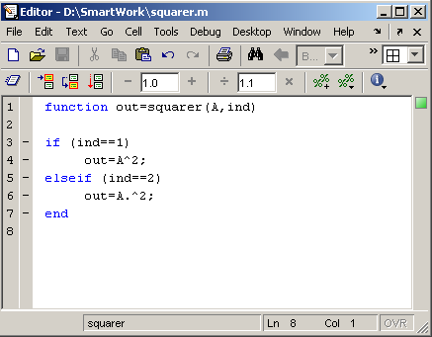
Writing User Defined Functions
Examples
  Write a function : out=squarer (A, ind)
    Which takes the square of the input matrix if the input indicator is equal to 1
    And takes the element by element square of the input matrix if the input indicator is equal to 2
Same Name

Slide 30
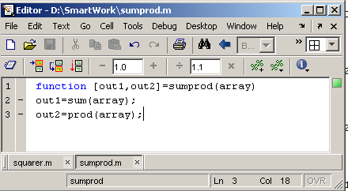
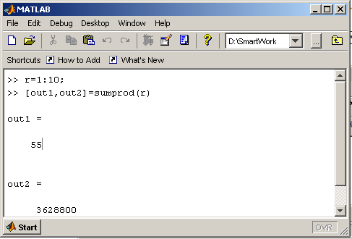
Writing User Defined Functions
Another function which takes an input array and returns the sum and product of its elements as outputs
The function sumprod(.) can be called from command window or an m-file as

Slide 31
Notes:
“%” is the neglect sign for Matlab (equaivalent of “//” in C). Anything after it on the same line is neglected by Matlab compiler.
Sometimes slowing down the execution is done deliberately for observation purposes. You can use the command “pause” for this purpose
pause %wait until any key
pause(3) %wait 3 seconds

Slide 32
Useful Commands
The two commands used most by Matlab
users are
>>help functionname
>>lookfor keyword

Slide 33
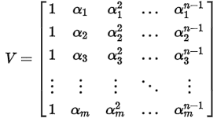
Exercise
The following is Vandermonde Matrix
Please write a function to form the Vandermonde Matrix based on one given vector, and show me a demo program in which the function is called.
Hint: the given vector is one of the input arguments, and the out argument is one matrix.

